Slide 1

Dynamic NeRF with Depth-Guided Supervision
Chang Luo
Advanced Deep Learning for Computer Vision Course Project
11.01.2023
Notes:
Ok, hello everyone. Let‘s start to talk about the project Dynamic NeRF with Depth-Guided Supervision.

Slide 2
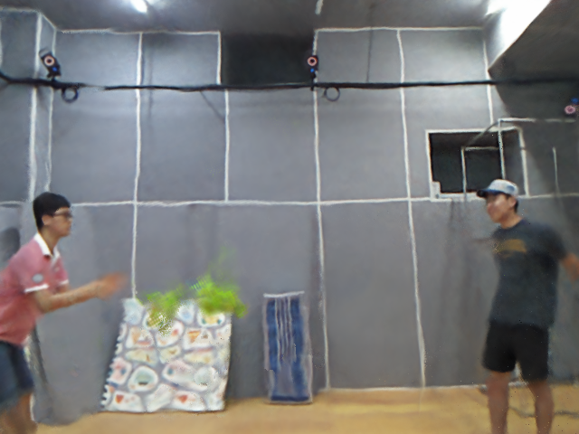
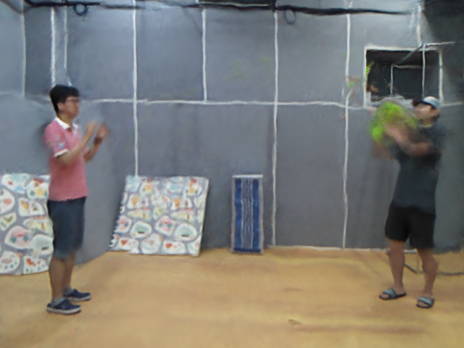
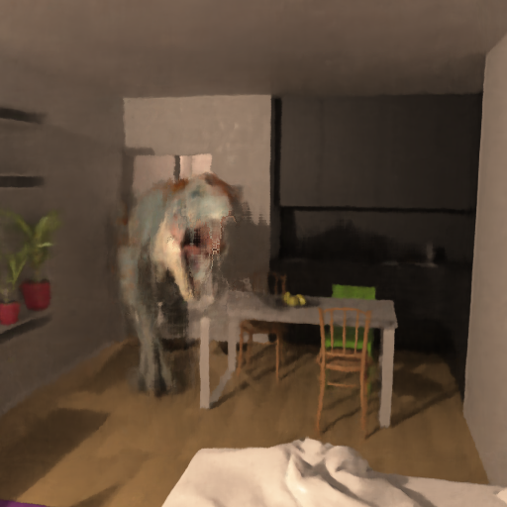
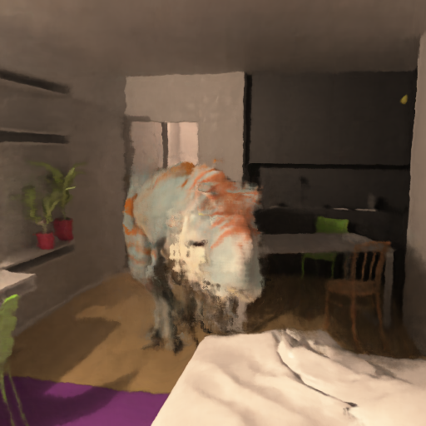
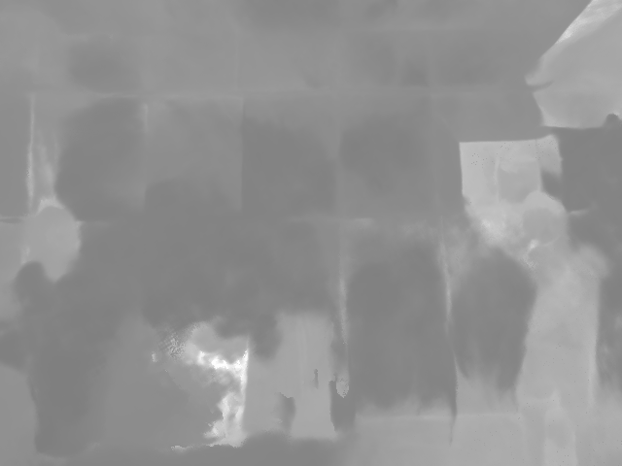
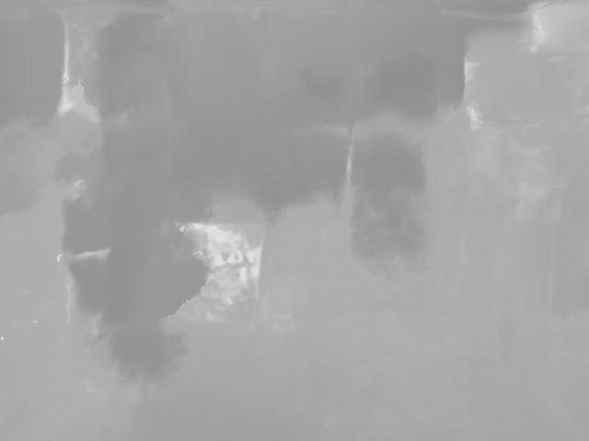
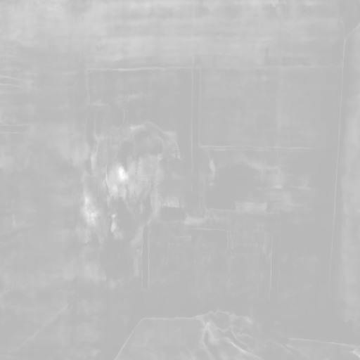
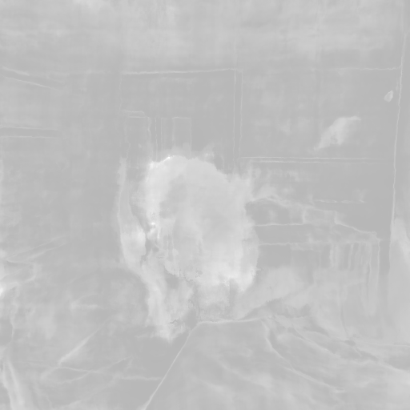
Motivation
We focus on Novel View Synthesis for Dynamic Scenes
We want to take advantage of Depth Information to constraint the problem

Slide 3
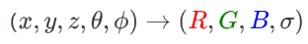
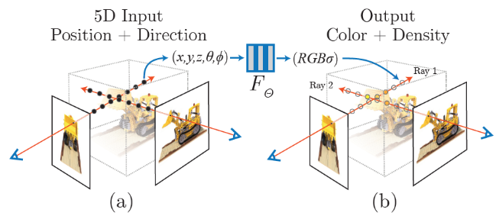
Related Work: NeRF
The paper NeRF: Representing Scenes as Neural Radiance Fields for View Synthesis
Learn such an implicit function

Slide 4
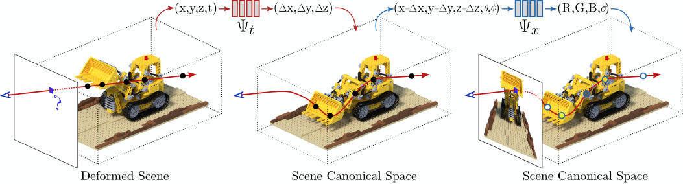
Related Work: Dynamic NeRF
How to adapt it for dynamic scenes?
Learn an offset Δ to get back canonical space (t=0)

Slide 5
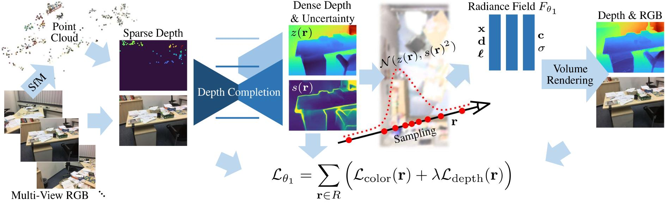
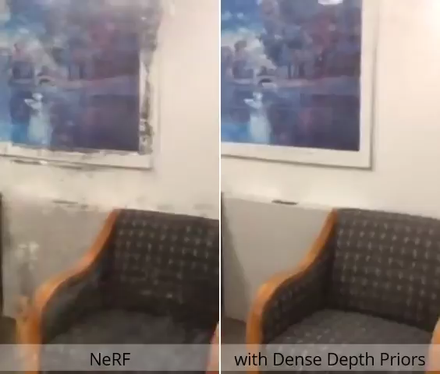
Related Work: Dense Depth Priors for NeRF from Sparse Input Views
Does Depth help to constraint the optimization?
Depth Guided Sampling & Depth Loss could be helpful!

Slide 6
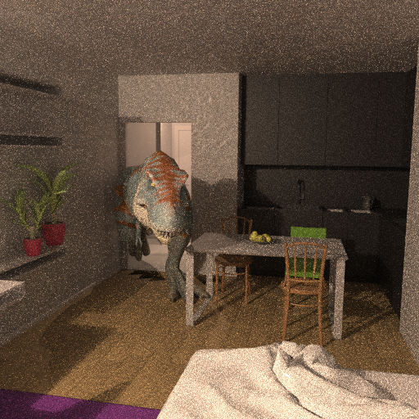
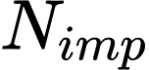
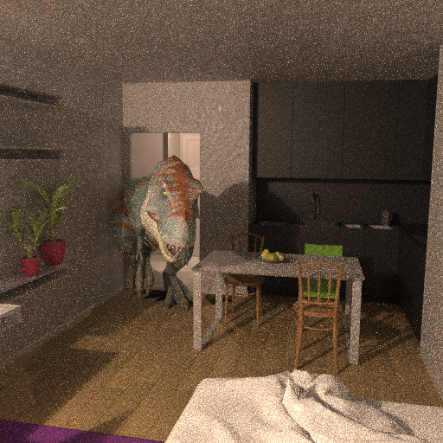
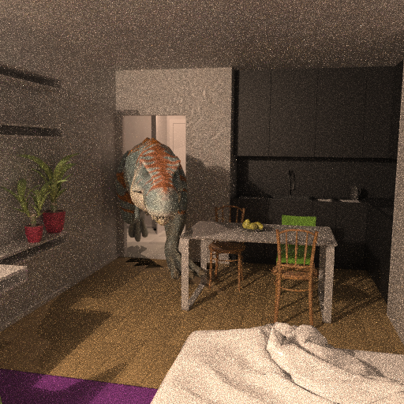
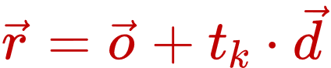
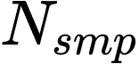
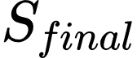
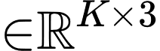
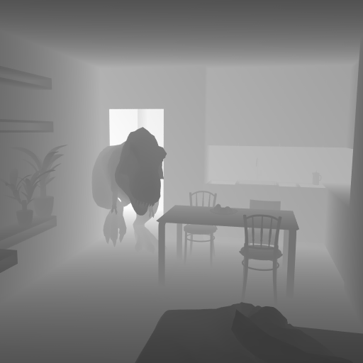
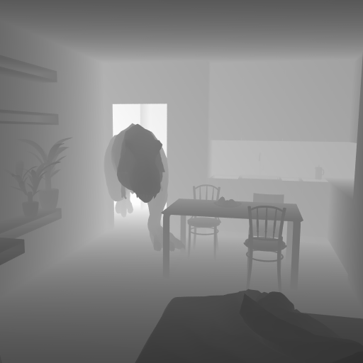
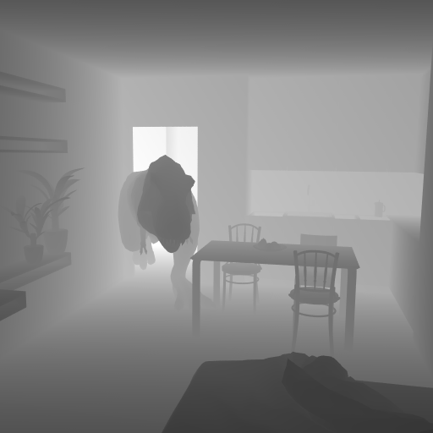
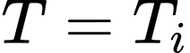
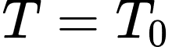
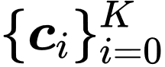
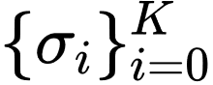
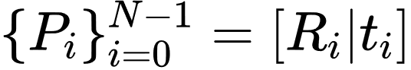
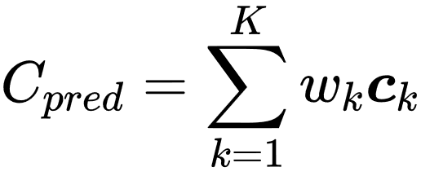
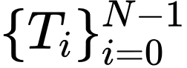
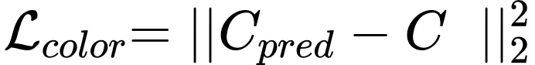
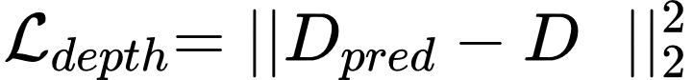
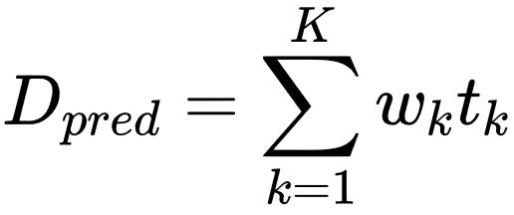
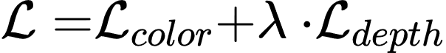
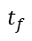
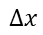
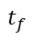
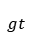
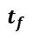
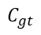

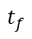
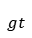
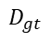
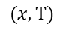
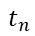
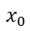

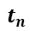

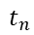
Methods
$$C_{gt}$$
Ray Sampler
$$D_{gt}$$
$$t_{n}$$
$$t_{f}$$
Get Rays
$$t_{f}$$
$$t_{f}$$
Two Pass
Samping
Depth Guided Sampling
$$t_{n}$$
$$t_{n}$$
$$t_{f}$$
RGB Frames
Rays Casting
Stratified Sampling
$$t_{n}$$
Final Ray
At timestep
At timestep
D-NeRF
$$(x,T)$$
$$Δx$$
$$x_{0}$$
$$t_{f}$$
…
…
$$t_{f}$$
…
…
Depth Frames
$$t_{n}$$
$$t_{n}$$
Deformed Space
MLP $Ψ_{t}$
Canonical Space
MLP $Ψ_{x}$
Camera Poses
Renderer
Loss function
$$t_{n}$$
$$t_{f}$$
Volume
Rendering
$$_{gt}$$
$$_{gt}$$
Time steps
Dataset

Slide 7
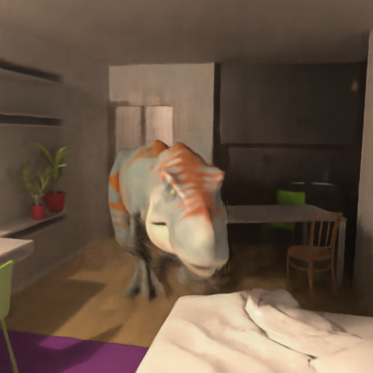











Current Results
Qualitative Result
Ours
D-NeRF
Groundtruth
Ours
D-NeRF
Groundtruth

Slide 8






Current Results
Qualitative Result
Notes:
We can also check this videos.

Slide 9
Current Results
Quantitative Result
DGS Enabled
PSNR↑ LPIPS↓ SSIM↑ RMSE↓
22.12 0.7313 0.3129 3.0537
22.11 0.7381 0.3085 0.4593
22.28 0.7374 0.3187 0.4203
w/o
-
with
x
with
-

Slide 10


Current Issues
Weird artefacts really hurts our metrics
Details are lost
Ours
D-NeRF
Groundtruth

Slide 11
Conclusion
The improvement on depth prediction is very apparent
The improvement on color can be confirmed visually, not that prominent in metrics
Next step:
Finish the training with GNLL to check the performance
Try a real world dataset to check outcome on real dataset
Tune model to get best metrics

Slide 12
Thank you for your attention!
Chang Luo
Advanced Deep Learning for Computer Vision Course Project
11.01.2023

Slide 13




Methods: Depth Loss Type
Mean Squared Error (MSE)
Gaussian Negative Log Likelihood Loss (GNLL)
Where
Will encourage NeRF to terminates rays
within the standard deviation!
Notes:
Besides, the naïve MSE, we can also use another Loss function which is Gaussian Negative Log Likelihood Loss to measure the depth error.
So here the S is the target standard deviation

